Slide 1
ME 4447 / 6405
Student Lecture
“Transistors”
Brooks Bryant
Will Roby
Frank Fearon

Slide 2
Lecture Overview
What is a transistor?
  Uses
  History
  Background Science
Transistor Properties
Types of transistors
  Bipolar Junction Transistors
  Field Effect Transistors
  Power Transistors

Slide 3
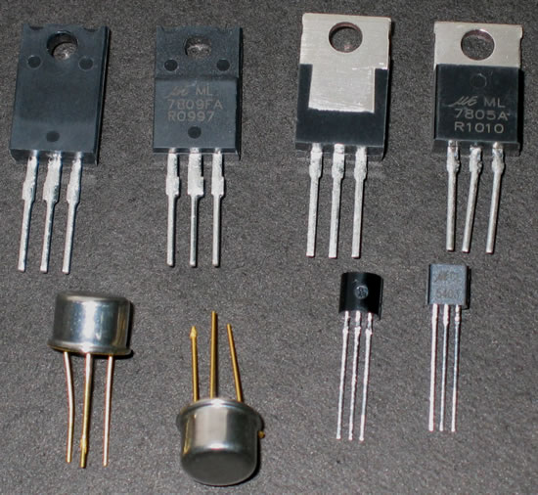
What is a transistor?
A transistor is a 3 terminal electronic device made of semiconductor material.
Transistors have many uses, including amplification, switching, voltage regulation, and the modulation of signals

Slide 4
History
Before transistors were invented, circuits used vacuum tubes:
  Fragile, large in size, heavy, generate large quantities of heat, require a large amount of power
The first transistors were created at Bell Telephone Laboratories in 1947
  William Shockley, John Bardeen, and Walter Brattain created the transistors in and effort to develop a technology that would overcome the problems of tubes
  The first patents for the principle of a field effect transistor were registered in 1928 by Julius Lillenfield.
  Shockley, Bardeen, and Brattain had referenced this material in their work
The word “transistor” is a combination of the terms “transconductance” and “variable resistor”
Today an advanced microprossesor can have as many as 1.7 billion transistors.

Slide 5
Background Science
Conductors
  Ex: Metals
  Flow of electricity governed by motion of free electrons
  As temperature increases, conductivity decreases due to more lattice atom collisions of electrons
  Idea of superconductivity
Insulators
  Ex: Plastics
  Flow of electricity governed by motion of ions that break free
  As temperature increases, conductivity increases due to lattice vibrations breaking free ions
  Irrelevant because conductive temperature beyond melting point

Slide 6
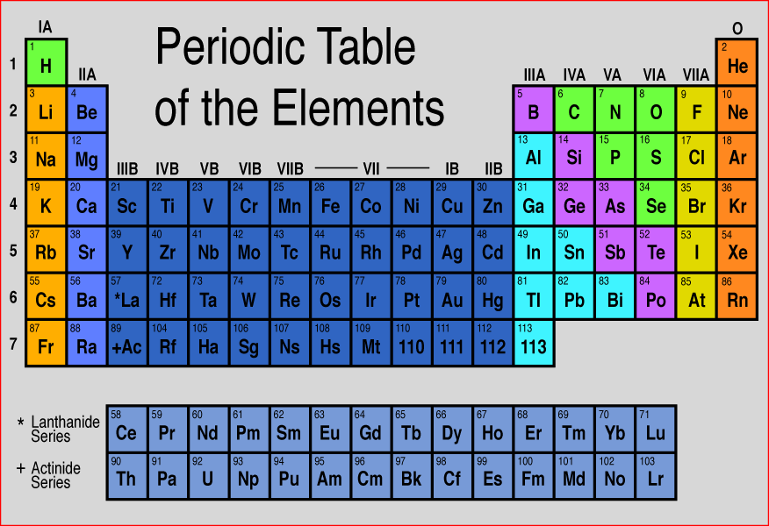
Semiconductors
Semiconductors are more like insulators in their pure form but have smaller atomic band gaps
Adding dopants allows them to gain conductive properties

Slide 7
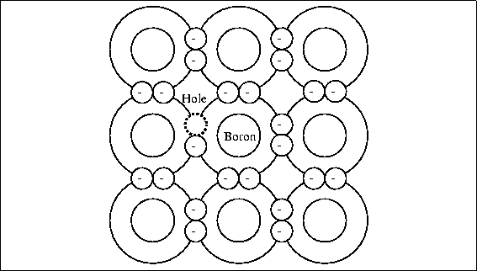
Doping
Foreign elements are added to the semiconductor to make it electropositive or electronegative
P-type semiconductor (postive type)
  Dopants include Boron, Aluminum, Gallium, Indium, and Thallium
  Ex: Silicon doped with Boron
  The boron atom will be involved in covalent bonds with three of the four neighboring Si atoms. The fourth bond will be missing and electron, giving the atom a “hole” that can accept an electron

Slide 8
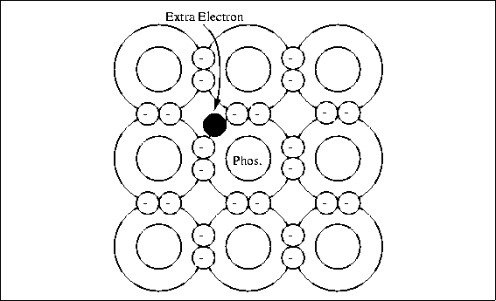
Doping
N-type semiconductor (negative type)
  Dopants include Nitrogen, Phosphorous, Arsenic, Antimony, and Bismuth
Ex: Silicon doped with Phosphorous
  The Phosphorous atom will contribute and additional electron to the Silicon giving it an excess negative charge

Slide 9
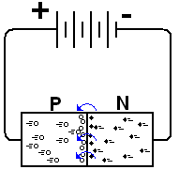
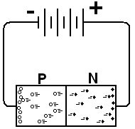
P-N Junction Diodes
Forward Bias
  Current flows from P to N
Reverse Bias
  No Current flows
  Excessive heat can cause dopants in a semiconductor device to migrate in either direction over time, degrading diode
  Ex: Dead battery in car from rectifier short
  Ex: Recombination of holes and electrons cause rectifier open circuit and prevents car alternator form charging battery

Slide 10
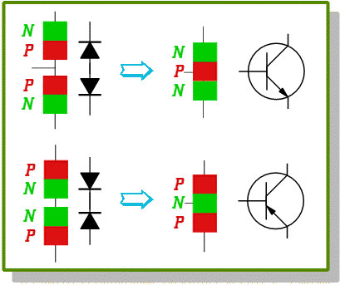
Back To The Question
What is a Transistor?
Bipolar Junction Transistors
NPN Transistor Most Common Configuration
Base, Collector, and Emitter
  Base is a very thin region with less dopants
  Base collector jusntion reversed biased
  Base emitter junction forward biased
  Fluid flow analogy:
  If fluid flows into the base, a much larger fluid can flow from the collector to the emitter
  If a signal to be amplified is applied as a current to the base, a valve between the collector and emitter opens and closes in response to signal fluctuations
PNP Transistor essentially the same except for directionality

Slide 11
BJT Transistors
BJT (Bipolar Junction Transistor)
  npn
    Base is energized to allow current flow
  pnp
    Base is connected to a lower potential to allow current flow
3 parameters of interest
  Current gain (β)
  Voltage drop from base to emitter when V_{BE}=V_{FB}
  Minimum voltage drop across the collector and emitter when transistor is saturated

Slide 12
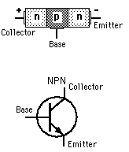
npn BJT Transistors
High potential at collector
Low potential at emitter
Allows current flow when the base is given a high potential

Slide 13
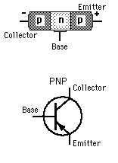
pnp BJT Transistors
High potential at emitter
Low potential at collector
Allows current flow when base is connected to a low potential

Slide 14
BJT Modes
Cut-off Region: V_{BE} < V_{FB}, i_{B}=0
  Transistor acts like an off switch
Active Linear Region: V_{BE}=V_{FB}, i_{B}≠0, i_{C}=βi_{B}
  Transistor acts like a current amplifier
Saturation Region: V_{BE}=V_{FB}, i_{B}>i_{C,max}/ β
  In this mode the transistor acts like an on switch
Power across BJT

Slide 15
Power Across BJT
P_{BJT} = V_{CE} * i_{CE}
Should be below the rated transistor power
Should be kept in mind when considering heat dissipation
Reducing power increases efficiency

Slide 16
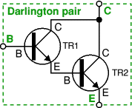
Darlington Transistors
Allow for much greater gain in a circuit
β = β₁ * β₂

Slide 17
FET Transistors
Analogous to BJT Transistors
FET Transistors switch by voltage rather than by current
BJT | FET
Collector | Drain
Base | Gate
Emitter | Source
N/A | Body
D
G
S

Slide 18
FET Transistors
FET (Field Effect Transistors)
  MOSFET (Metal-Oxide-Semiconductor Field-Effect Transistor)
  JFET (Junction Field-Effect Transistor)
  MESFET
  HEMT
  MODFET
Most common are the n-type MOSFET or JFET

Slide 19
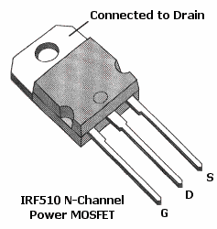
FET Transistors – Circuit Symbols
MOSFET
In practice the body and source leads are almost always connected
Most packages have these leads already connected
D
D
G
B
G
B
S
S
JFET
D
G
S

Slide 20
FET Transistors – How it works
The “Field Effect”
The resulting field at the plate causes electrons to gather
As an electron bridge forms current is allowed to flow
Plate
Semi-conductor

Slide 21
FET Transistors
JFET
MOSFET
gate
gate
drain
source
P
N
N
drain
N
source
P

Slide 22
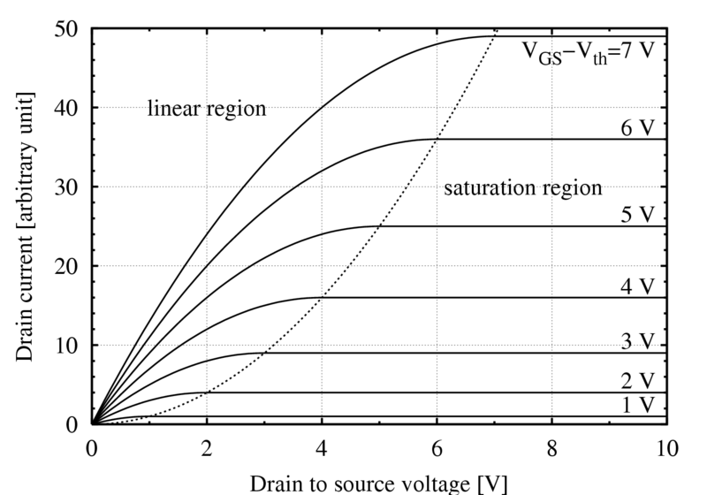
FET Transistors – Characteristics
Current flow
D
G
B
S

Slide 23
FET Transistors – Regions
Region | Criteria | Effect on Current
Cut-off | V_{GS} < V_{th} | I_{DS}=0
Linear | V_{GS} > V_{th} And V_{DS} <V_{GS}-V_{th} | Transistor acts like a variable resistor, controlled by V_{gs}
Saturation | V_{GS} > V_{th} And V_{DS} >V_{GS}-V_{th} | Essentially constant current
Current flow
D
G
B
S

Slide 24
JFET vs MOSFET Transistors
MOSFET | JFET
High switching speed | Will operate at V_{G}<0
Can have very low R_{DS} | Better suited for low signal amplification
Susceptible to ESD
More commonly used as a power transistor
Current flow
D
G
B
S

Slide 25
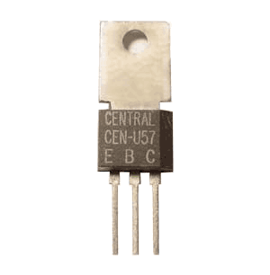
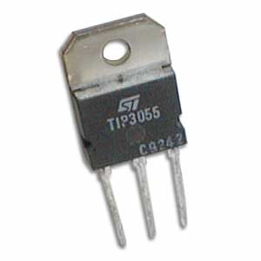
Power Transistors
Additional material for current handling and heat dissipation
Can handle high current and voltage
Functionally the same as normal transistors

Slide 26
Transistor Uses
Switching
Amplification
Variable Resistor

Slide 27
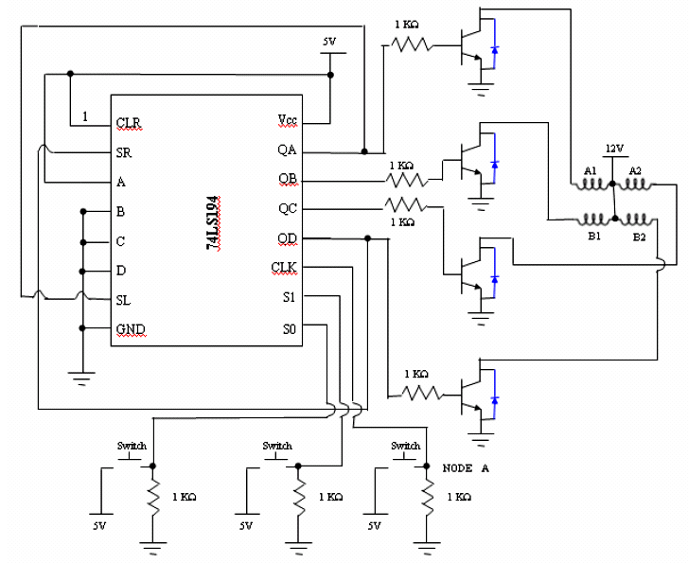

Practical Examples - Switching

Slide 28
Practical Examples - PWM
Power to motor is proportional to duty cycle
MOSFET transistor is ideal for this use
DC motor

Slide 29
Practical Examples – Darlington Pair
Transistors can be used in series to produce a very high current gain

Slide 30
Questions?

Slide 31
Image references
http://www.owlnet.rice.edu/~elec201/Book/images/img95.gif
http://nobelprize.org/educational_games/physics/transistor/function/p-type.html
http://www.electronics-for-beginners.com/pictures/closed_diode.PNG
http://people.deas.harvard.edu/~jones/es154/lectures/lecture_3/dtob.gif
http://en.wikipedia.org/wiki/Image:IvsV_mosfet.png
http://www.physlink.com/Education/AskExperts/ae430.cfm
http://www.kpsec.freeuk.com/trancirc.htm

Slide 32
Technical References
Sabri Cetinkunt; Mechatronics
  John Wiley and sons; 2007

